Slide 1
Chapter (2)
Database System Concepts and Architecture
A. Mohammed Khalifa

Slide 2
Chapter 2 Outline
1 Data Models and Their Categories
2 Schemas, Instances, and States
3 Three-Schema Architecture and Data Independence
4 DBMS Languages and Interfaces
5 Database System Architectures
6 Classification of DBMSs
7 History of Data Models

Slide 3
1 Data Models and Their Categories

Slide 4
Data Models
Data Model:
  A set of concepts to describe the structure of a database, the operations for manipulating the data, and the constraints that the data should follow.
Data Model Structure and Constraints:
  Data Model constructs define the database structure, it include: data elements and their data types (often called attributes); grouping of related elements into entities (also called objects or records or tuples); and relationships among entities
  Constraints specify restrictions on the stored data; the data that satisfies the constraints is called valid data

Slide 5
Categories of Data Models
Conceptual (high-level, semantic) data models:
  Provide concepts that are close to the way many users perceive (understand) data.
    (Also called entity-based or object-based data models.)
Physical (low-level, internal) data models:
  Provide concepts that describe details of how data is stored in the computer.
Implementation (representational) data models:
  Provide concepts that fall between the above two, used by many commercial DBMS implementations (e.g. relational data models used in many commercial systems).

Slide 6
2 Schemas, Instances, and States

Slide 7
Database Schema versus Database State
Database Schema:
  The description of a database.
  Includes descriptions of the database structure, relationships, data types, and constraints
Schema Diagram:
  An illustrative display of a database schema
Schema Construct:
  A component of the schema or an object within the schema, e.g., STUDENT, COURSE, Name

Slide 8
Database Schema vs. Database State (cont.)
Database State:
  The actual data stored in a database at a particular moment in time. This includes the collection of all the data in the database.
  Also called a database instance (or occurrence or snapshot).

Slide 9
Database Schema vs. Database State (cont.)
Database State:
  Refers to the content of a database at a particular moment in time.
Initial Database State:
  Refers to the database state when it is initially loaded into the system.
Valid State:
  A state that satisfies the structure and constraints of the database.

Slide 10
Database Schema vs. Database State (cont.)
Distinction
  The database schema changes very infrequently.
  The database state changes every time the database is updated.

Slide 11

Example of a Database Schema

Slide 12
3 Three-Schema Architecture and Data Independence

Slide 13
Three-Schema Architecture
Proposed to support DBMS characteristics of:
  Program-data independence.
  Support of multiple views of the data.
Not explicitly used in commercial DBMS products, but has been useful in explaining database system organization

Slide 14
Three-Schema Architecture (cont.)
Defines DBMS schemas at three levels:
  Internal schema at the internal level to describe physical storage structures and access paths (e.g indexes).
    Typically uses a physical data model.
  Conceptual schema at the conceptual level to describe the structure and constraints for the whole database for a community of users. Uses an implementation (or a conceptual) data model.
  External schemas at the external level to describe the various user views.
    Usually uses the same data model as the conceptual schema.

Slide 15

Three-Schema Architecture (cont.)

Slide 16
Three-Schema Architecture (cont.)
Mappings among schema levels are needed to transform requests and data.

Slide 17
Data Independence
Logical Data Independence:
  The capacity to change the conceptual schema without having to change the external schemas and their associated application programs.
Physical Data Independence:
  The capacity to change the internal schema without having to change the conceptual schema.
  For example, the internal schema may be changed when certain file structures are reorganized or new indexes are created to improve database performance

Slide 18
Data Independence (cont.)
When a schema at a lower level is changed, only the mappings between this schema and higher-level schemas need to be changed in a DBMS that fully supports data independence.

Slide 19
4 DBMS Languages and Interfaces

Slide 20
DBMS Languages
Data Definition Language (DDL):
  Used by the DBA and database designers to specify the conceptual schema of a database.
  In many DBMSs, the DDL is also used to define internal and external schemas (views).
  Theoretically, could be separated into storage definition language (SDL) and view definition language (VDL)

Slide 21
DBMS Languages (cont.)
Data Manipulation Language (DML):
  Used to specify database retrievals and updates
  DML commands (data sublanguage) can be embedded in a general-purpose programming language (host language), such as COBOL, C, C++, or Java (see Chapter 13)

Slide 22
DBMS Interfaces
Stand-alone query language interfaces
  Example: Typing SQL queries directly through the DBMS interactive SQL interface (e.g. SQL*Plus in ORACLE)
Programmer interfaces for embedding DML in programming languages
User-friendly interfaces (often Web-based)
  Menu-based, forms-based, graphics-based, etc.

Slide 23

Typical DBMS Component Modules

Slide 24
5 Database Management System Architectures

Slide 25
DBMS Architectures
Centralized DBMS Architecture:
  Combines everything into single computer system, including: DBMS software, hardware, application programs, and user interface processing software.
  User can still connect through a remote terminal – however, all processing is done at centralized site (computer).

Slide 26

A Physical Centralized Architecture

Slide 27
DBMS Architectures (cont.)
Basic 2-tier Client-Server Architecture: Specialized Server nodes with Specialized functions
  Print server
  File server
  DBMS server
  Web server
  Email server
Client nodes can access the specialized servers as needed

Slide 28

Logical two-tier client server architecture

Slide 29
Three Tier Client-Server Architecture
Common for Web applications
Third intermediate layer (middle tier) called Application Server or Web Server:
Three-tier Architecture Can Enhance Security:

Slide 30

Three-tier client-server architecture

Slide 31
6 Classification of DBMSs

Slide 32
Classification of DBMSs
Based on the data model used
  Network DBMS
  Hierarchical DBMS
  Relational DBMS
Based on number of database users
  Single-user DBMS (Microsoft Access)
  Multiusers DBMS (Oracle, My SQL and SQL Server)

Slide 33
History of Data Models
Network Model
Hierarchical Model
Relational Model
Object-oriented Data Models
Object-Relational Models

Slide 34
History of Data Models (cont.)
Network Model:
  The first network DBMS was implemented by Honeywell in 1964-65 (IDS System).
  Adopted heavily due to the standard support by CODASYL (Conference on Data Systems Languages) (CODASYL - DBTG report of 1971).
  Later implemented in a large variety of systems - IDMS (Cullinet - now Computer Associates), DMS 1100 (Unisys), IMAGE (H.P. (Hewlett-Packard)), VAX -DBMS (Digital Equipment Corp., next COMPAQ, now H.P.).

Slide 35
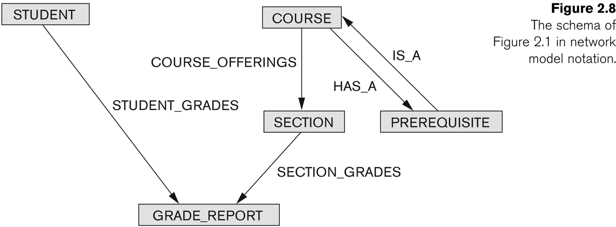
Example of Network Model Schema

Slide 36
Network Model
Disadvantages:
  Navigational and procedural nature of processing requires programming access
  Intermixes storage structures with conceptual modeling relationships
  Database contains a complex array of pointers that thread through a set of records.
    Little scope for automated “query optimization”

Slide 37
History of Data Models (cont.)
Hierarchical Data Model:
  Initially implemented in a joint effort by IBM and North American Rockwell around 1965. Resulted in the IMS family of systems.
  IBM’s IMS product had a very large customer base worldwide
  Hierarchical model was formalized based on the IMS system
  Other systems based on this model: System 2k (SAS inc.)

Slide 38
Hierarchical Model
Advantages:
  Can implement certain tasks very efficiently
  Easy to store hierarchically organized data, e.g., organization (“org”) charts
Disadvantages:
  Navigational and procedural nature of processing
  Difficult to store databases where multiple relationships exist among the data records
  Little scope for “query optimization” by system (programmer must optimize the programs)
  Language is procedural: Uses constructs like GET, GET UNIQUE, GET NEXT, GET NEXT WITHIN PARENT, etc.

Slide 39
History of Data Models (cont.)
Relational Model:
  Proposed in 1970 by E.F. Codd (IBM), first commercial systems in early 1980s.
  Now in many commercial products (e.g. DB2, ORACLE, MS SQL Server, SYBASE, INFORMIX).
  Several free open source implementations, e.g. MySQL, PostgreSQL
  Currently most dominant for developing database applications.
  SQL relational standards: SQL-89 (SQL1), SQL-92 (SQL2), SQL-99, SQL3, SQL-2008
  Chapters 3 through 6 describe this model in detail

Slide 40
History of Data Models (cont.)
Object-oriented Data Models:
  Allow databases to be used seamlessly with object-oriented programming languages.
  Can store persistent objects created in O-O Programming Languages such as C++ (e.g., in OBJECTSTORE or VERSANT), and Smalltalk (e.g., in GEMSTONE).
  Other experimental systems include O2, ORION (at MCC - then ITASCA), IRIS (at H.P.- used in Open OODB).
  Object Database Standard: ODMG-93, ODMG-version 2.0, ODMG-version 3.0.
  Chapter 11 describes this model.

Slide 41
History of Data Models (cont.)
Object-Relational Models:
  Relational systems incorporated concepts from object databases leading to object-relational.
  Exemplified in the latest versions of Oracle-10i, DB2, and SQL Server and other DBMSs.
  Standards started in SQL-99 and enhanced in SQL-2008.
  Chapter 11 also describes this model.

